Slide 1



Lesson 5: CSS (Part 3)
<Web />
Front-end
Development
University of Tehran
Lecturer:
Misagh Mohaghegh
ACM
Summer of Code 2024

Slide 2
A Short Review…
Font types (sans-serif, serif, mono, cursive, fantasy)
Font properties (font-family, font-size, font-style, font-weight, @font-face)
rem and em units
ch, vw, vh, and % units
Pseudo-classes (:hover, inputs(:disabled, :invalid), links(:link, :visited))
DOM pseudo-classes (:root, :first-child, :nth-child(n))
Pseudo-elements (::first-letter, ::first-line, ::selection, ::placeholder, ::marker, ::before)
Specificity (1-0-0, !important)
Reset and Normalize
Image object fit and filters

Slide 3
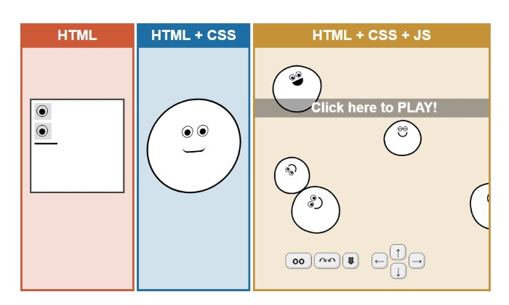
Continue…

Slide 4

Cascading Style Sheets

Slide 5
Position

Slide 6
Positioning Methods
There are 5 different position property values:
static
relative
absolute
fixed
sticky
After the position property is set, the four top, right, bottom, and left properties set the final location of the element.
The default position for elements is static:
* {
position: static;
}

Slide 7
Inset
inset is a shorthand property that sets the top, right, bottom, and left properties.
The syntax is similar to margin and padding.
#element {
inset: 10px 0 0 20px; /* top: 10px, left: 20px */
inset: 10px 0; /* top and bottom: 10px */
}

Slide 8
Static Position
This is the default positioning of all elements.
The top, right, bottom, and left properties have no effect in this mode.
The elements are positioned according to the normal flow of the page.

Slide 9
Relative Position
A position: relative element is positioned relative to its normal position.
This means that the element is first positioned normally, then is adjusted by the top, right, bottom, and left offsets.
This moves the element relative to its normal static flow position, but it does not affect how other elements interact with it (gaps created by relatively moving are not filled by other elements).
.elem {
position: relative;
left: 10px;
}

Slide 10
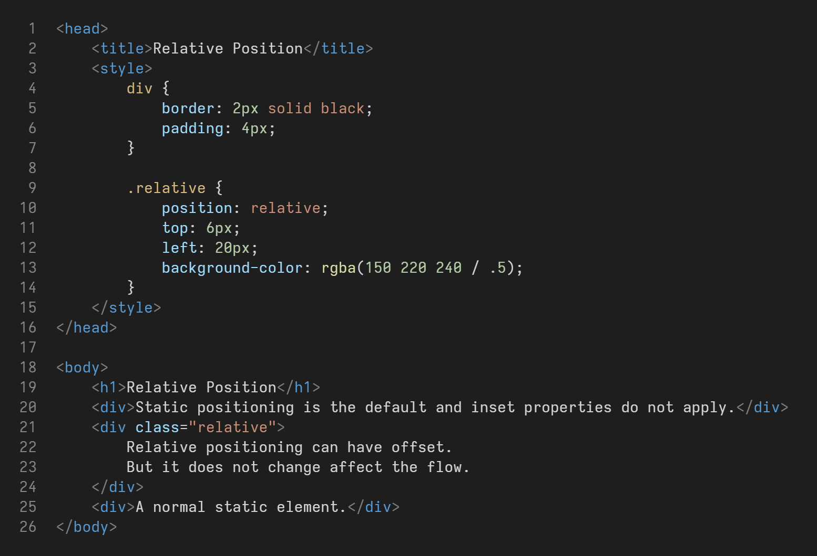
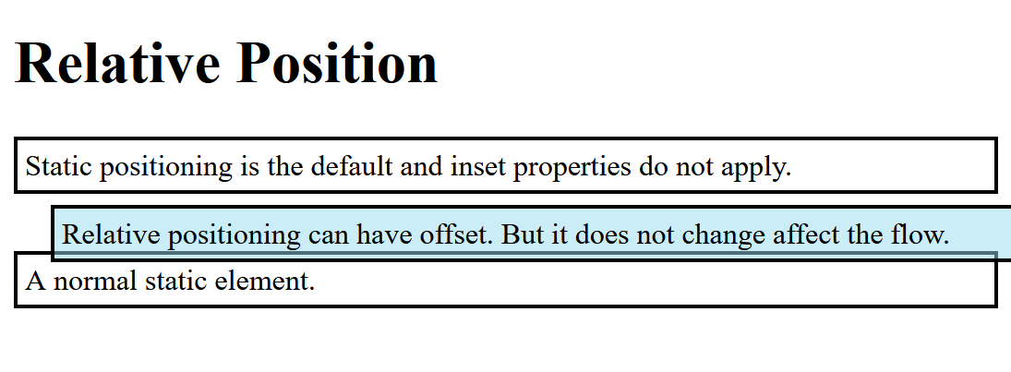
Relative Position

Slide 11
Fixed Position
A position: fixed element is positioned relative to the viewport.
The element is removed from the normal flow of the page (no space is reserved for it). The element is at the front of the viewport and is adjusted by the top, right, bottom, and left offsets.
.elem {
position: fixed;
top: 20px;
left: 10px;
}

Slide 12
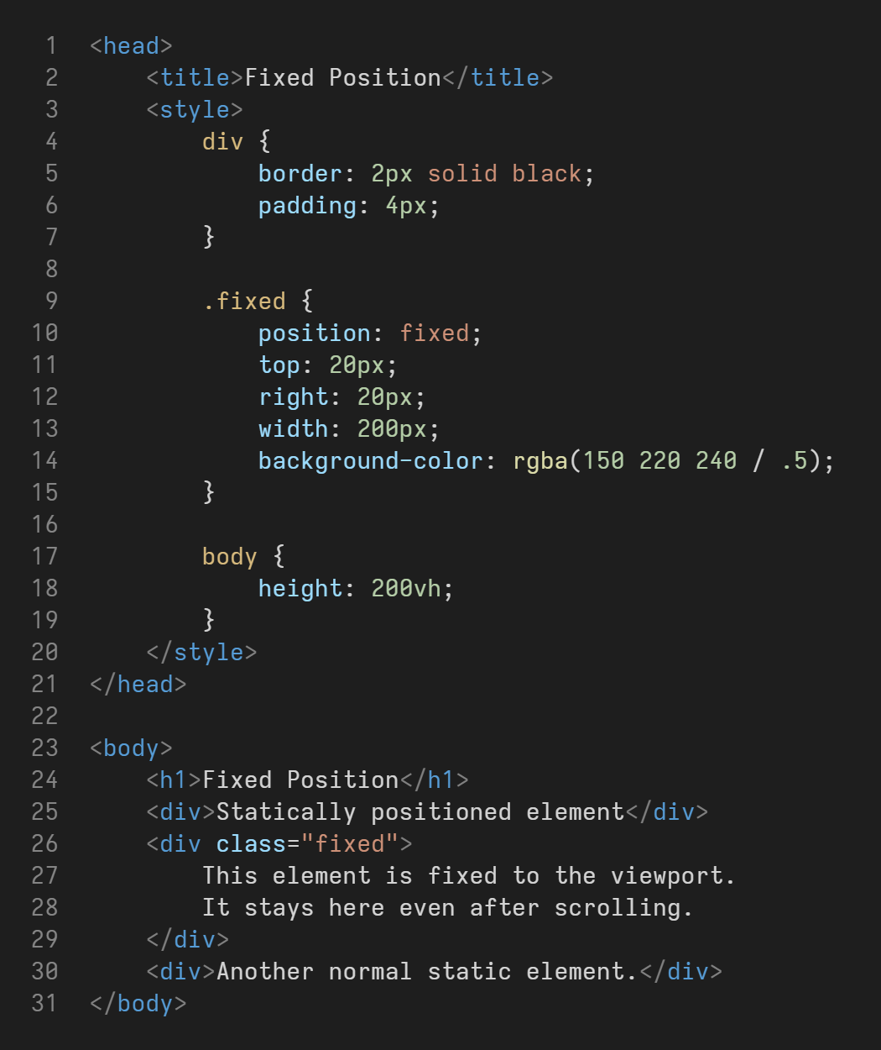
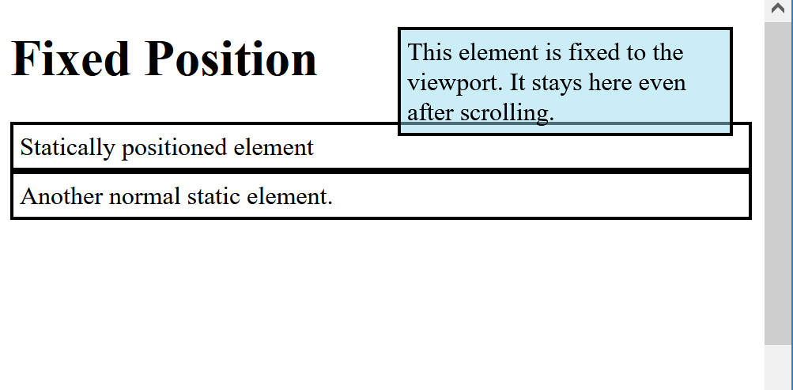
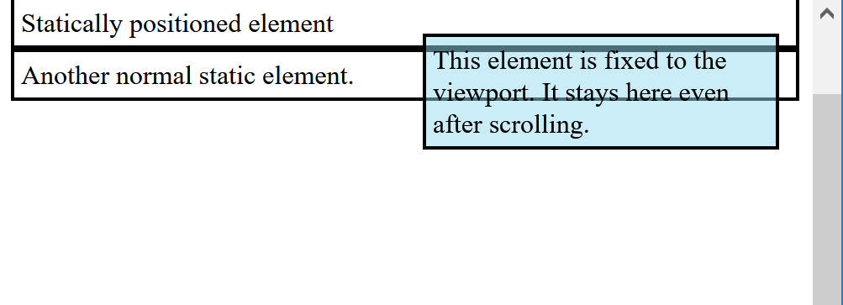
Fixed Position

Slide 13
Absolute Position
A position: absolute element is positioned relative to the nearest positioned ancestor.
The element is removed from the normal flow of the page (no space is reserved for it). If there is no positioned ancestor, it is like fixed positioning and relative to the viewport.
.parent {
position: relative;
}
.elem {
position: absolute;
top: 20px;
left: 10px;
}

Slide 14
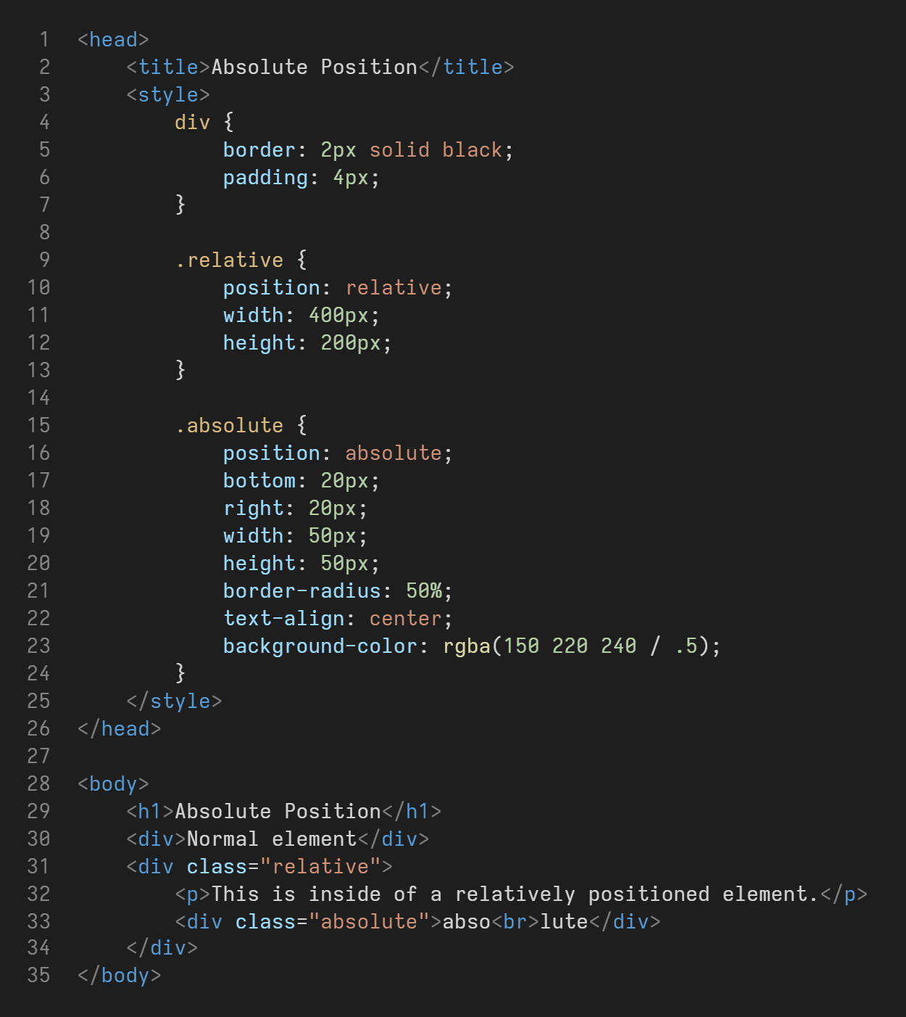
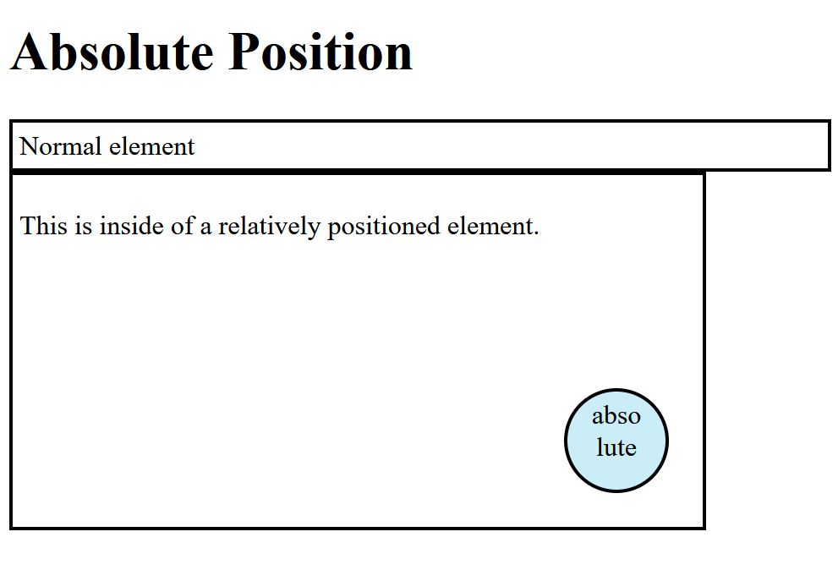
Absolute Position

Slide 15
Sticky Position
A position: sticky element is positioned based on the scroll position.
The element is only removed from the normal flow if we scroll past it.
It is as if the element is position: relative, and becomes position: fixed after we scroll.
.elem {
position: sticky;
top: 20px;
left: 10px;
}

Slide 16
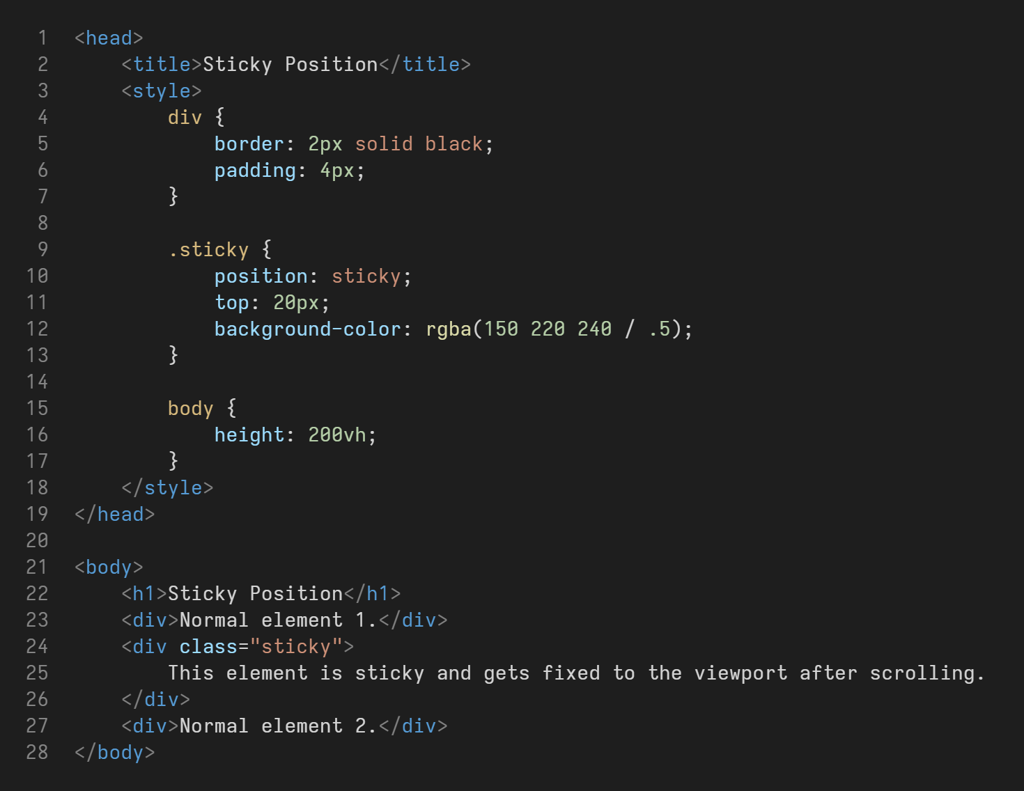
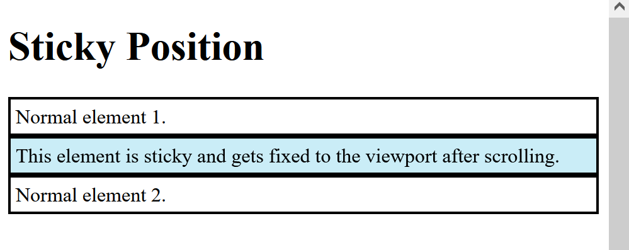
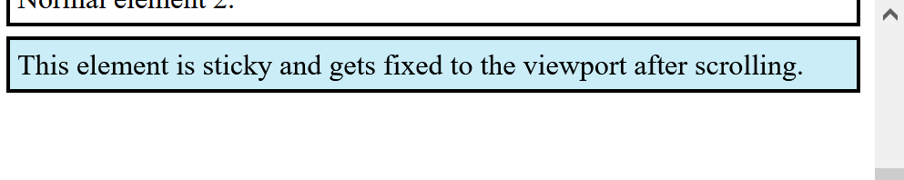
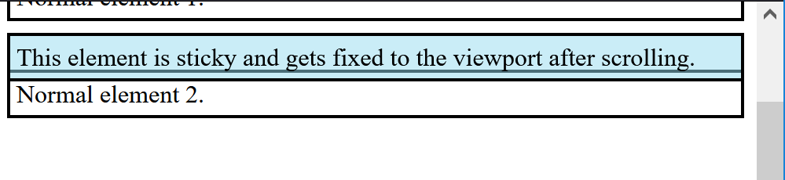
Sticky Position

Slide 17
Flexbox

Slide 18
Layouts
Flexbox is a layout module.
Before flexbox, we had the choices of block and inline elements, tables for making 2D data, positions for explicit placement of elements, and float for placing block elements next to each other.
Flexbox makes creating flexible and responsive layout structures easy.

Slide 19
Flex Container
To use the flexbox model, we have to first define a flex container.
.flex-container {
display: flex;
}
Now any direct children of an element which has display: flex, is a flex item.
By default, the flex items are aligned in a row next to each other.

Slide 20
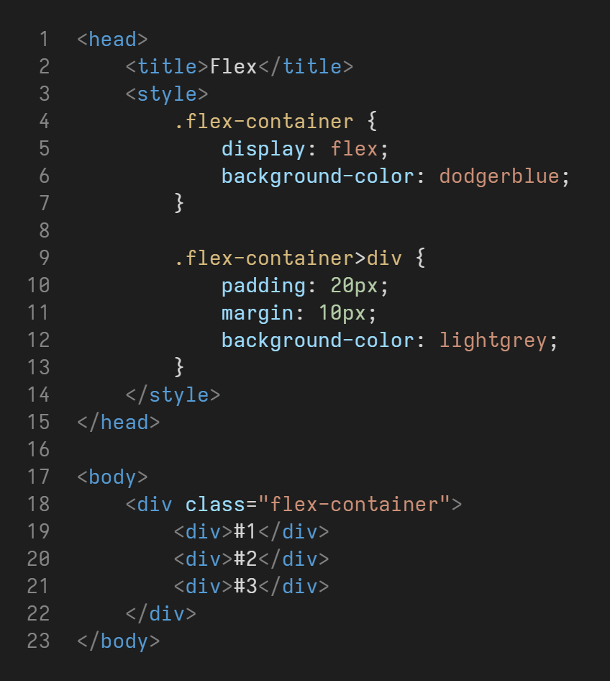
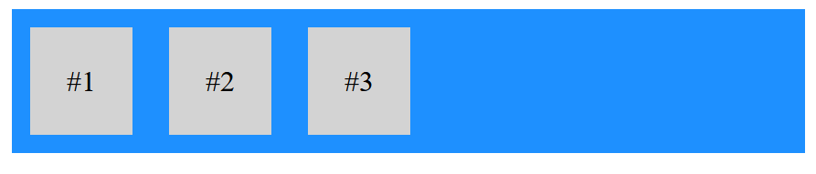
Flex Container

Slide 21
Container Properties
The flexbox container (the parent div with display: flex) can have the following properties:
flex-direction
flex-wrap
flex-flow
justify-content
align-items
align-content
gap

Slide 22
Flex Direction
The flexbox direction is the direction that flex items are aligned.
This is row by default and can be changed to column using the flex-direction property:
.flex-container {
display: flex;
flex-direction: column;
}
There is also row-reverse and column-reverse which stack the items in the opposite direction.
Row is left to right and column is top to bottom.

Slide 23
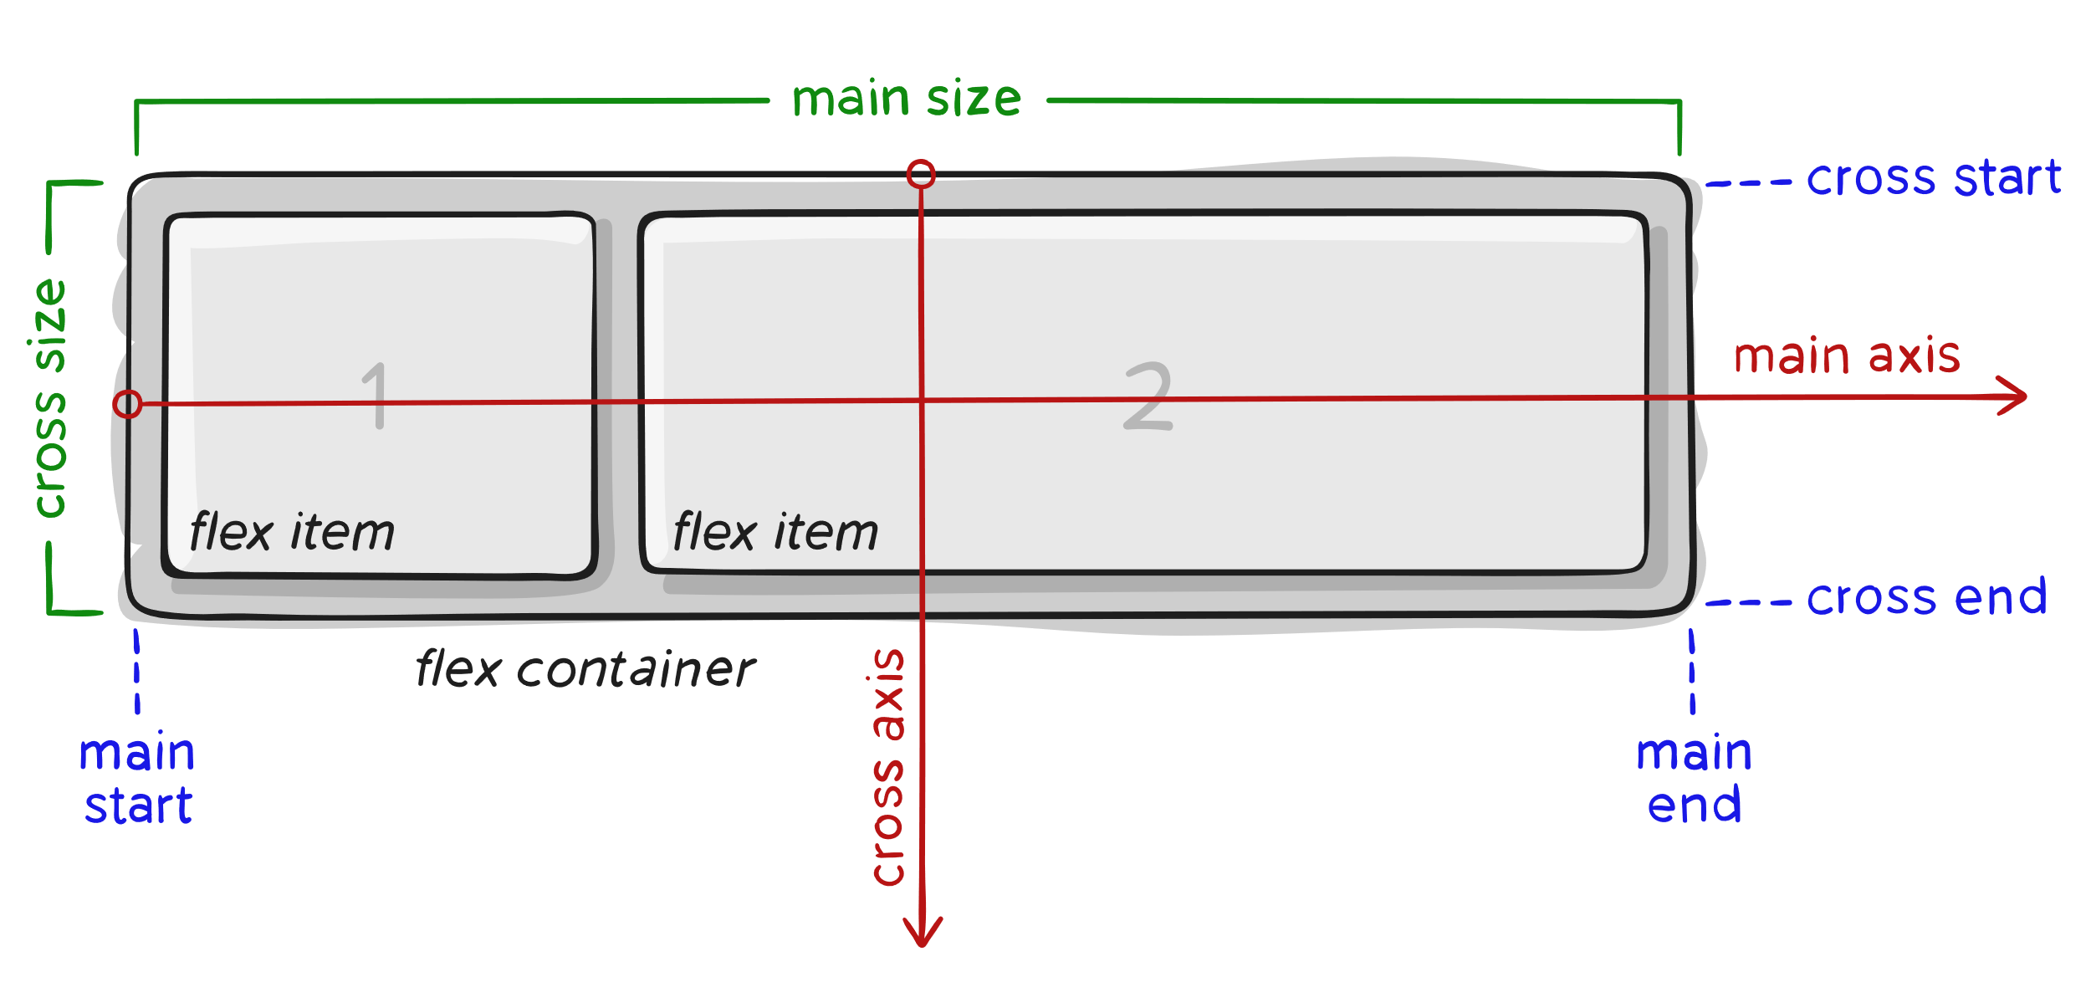
Flex Direction
To better understand flexbox, we need to understand the flex flow directions (main and cross axis):

Slide 24
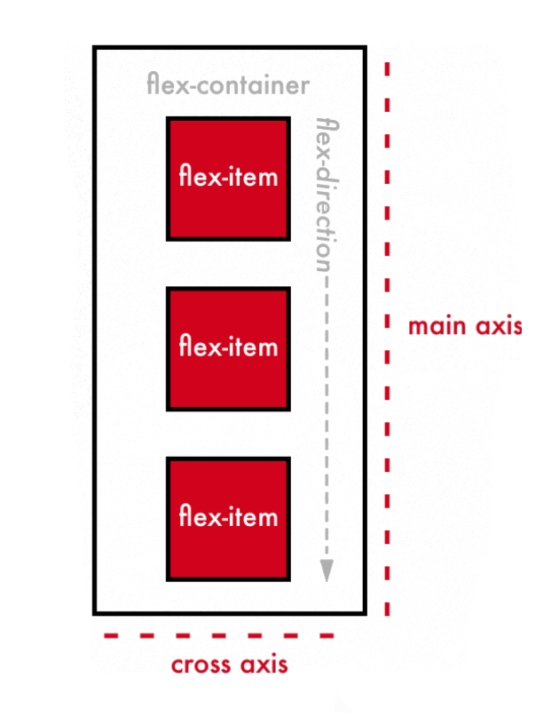
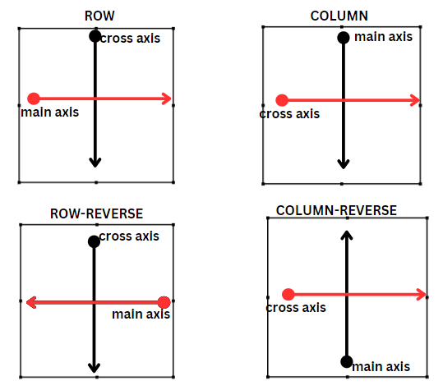
Flex Direction

Slide 25
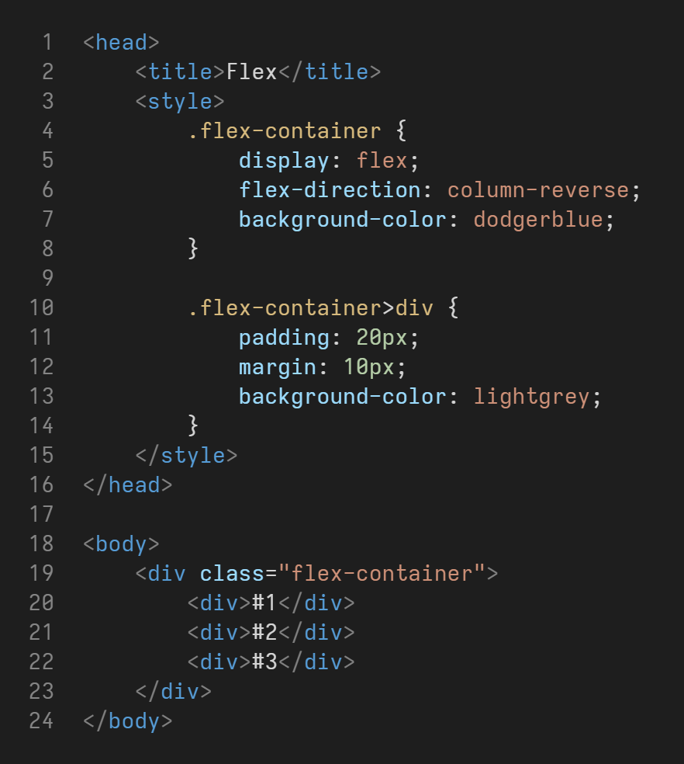
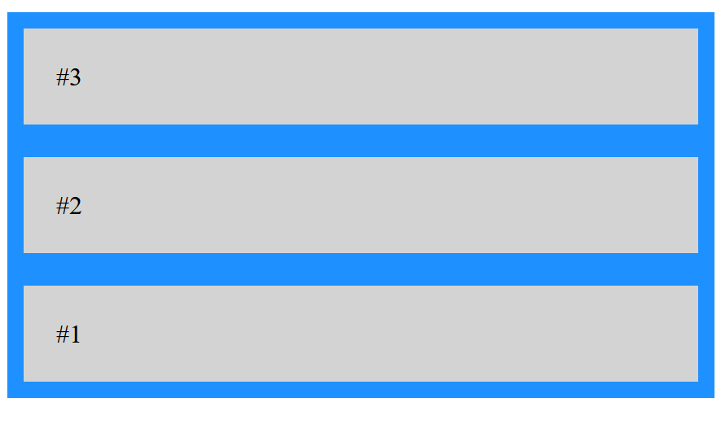
Flex Direction

Slide 26
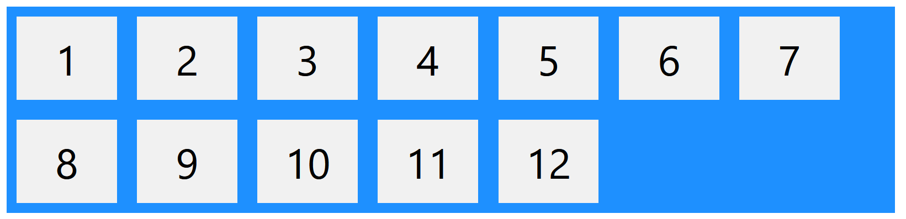
Flex Wrap
flex-wrap allows wrapping of flex items into a new line if there are too many of them.
The default value is nowrap, and can become wrap or wrap-reverse.
.flex-container {
display: flex;
flex-wrap: wrap;
}

Slide 27
Flex Flow
flex-flow is a shorthand property for flex-direction and flex-wrap:
flex-flow: flex-direction flex-wrap
.flex-container {
display: flex;
flex-flow: row wrap;
}

Slide 28
Justify Content
justify-content aligns the flex items on the main axis.
Accepted values are: center, flex-start (default), flex-end, space-around, space-between, space-evenly.
.flex-container {
display: flex;
justify-content: center;
}

Slide 29
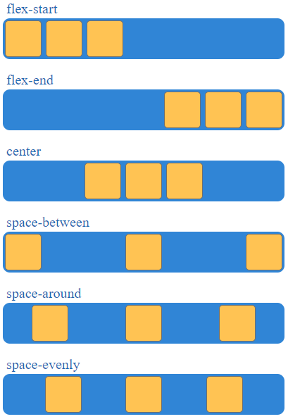
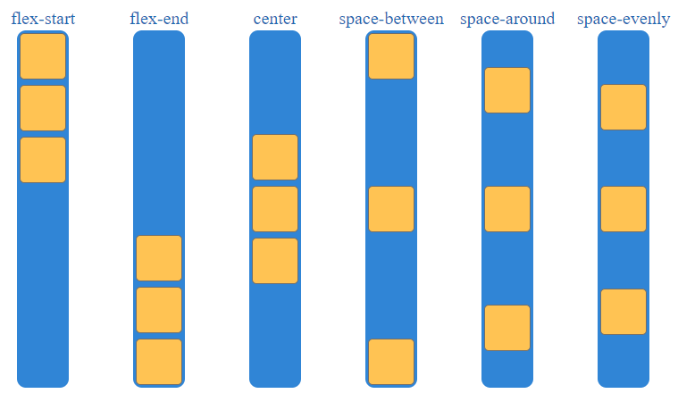
Justify Content

Slide 30
Align Items
align-items aligns the flex items on the cross axis.
Accepted values are: center, flex-start, flex-end, stretch (default), baseline.
.flex-container {
display: flex;
align-items: center;
}

Slide 31
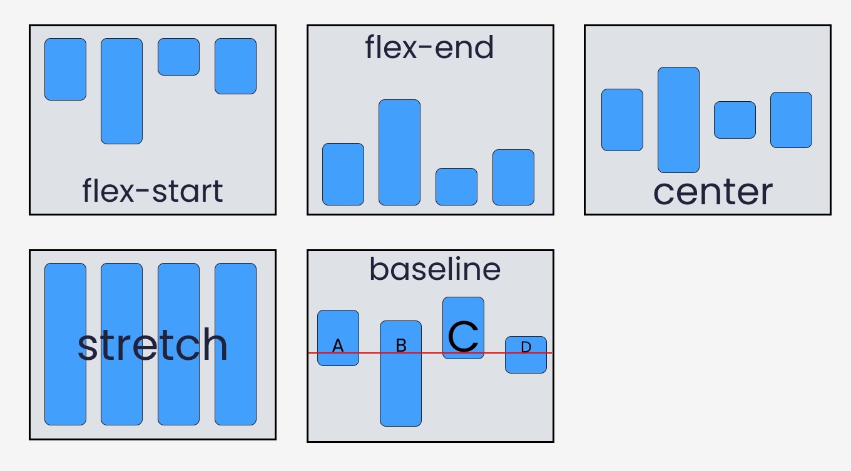
Align Items

Slide 32
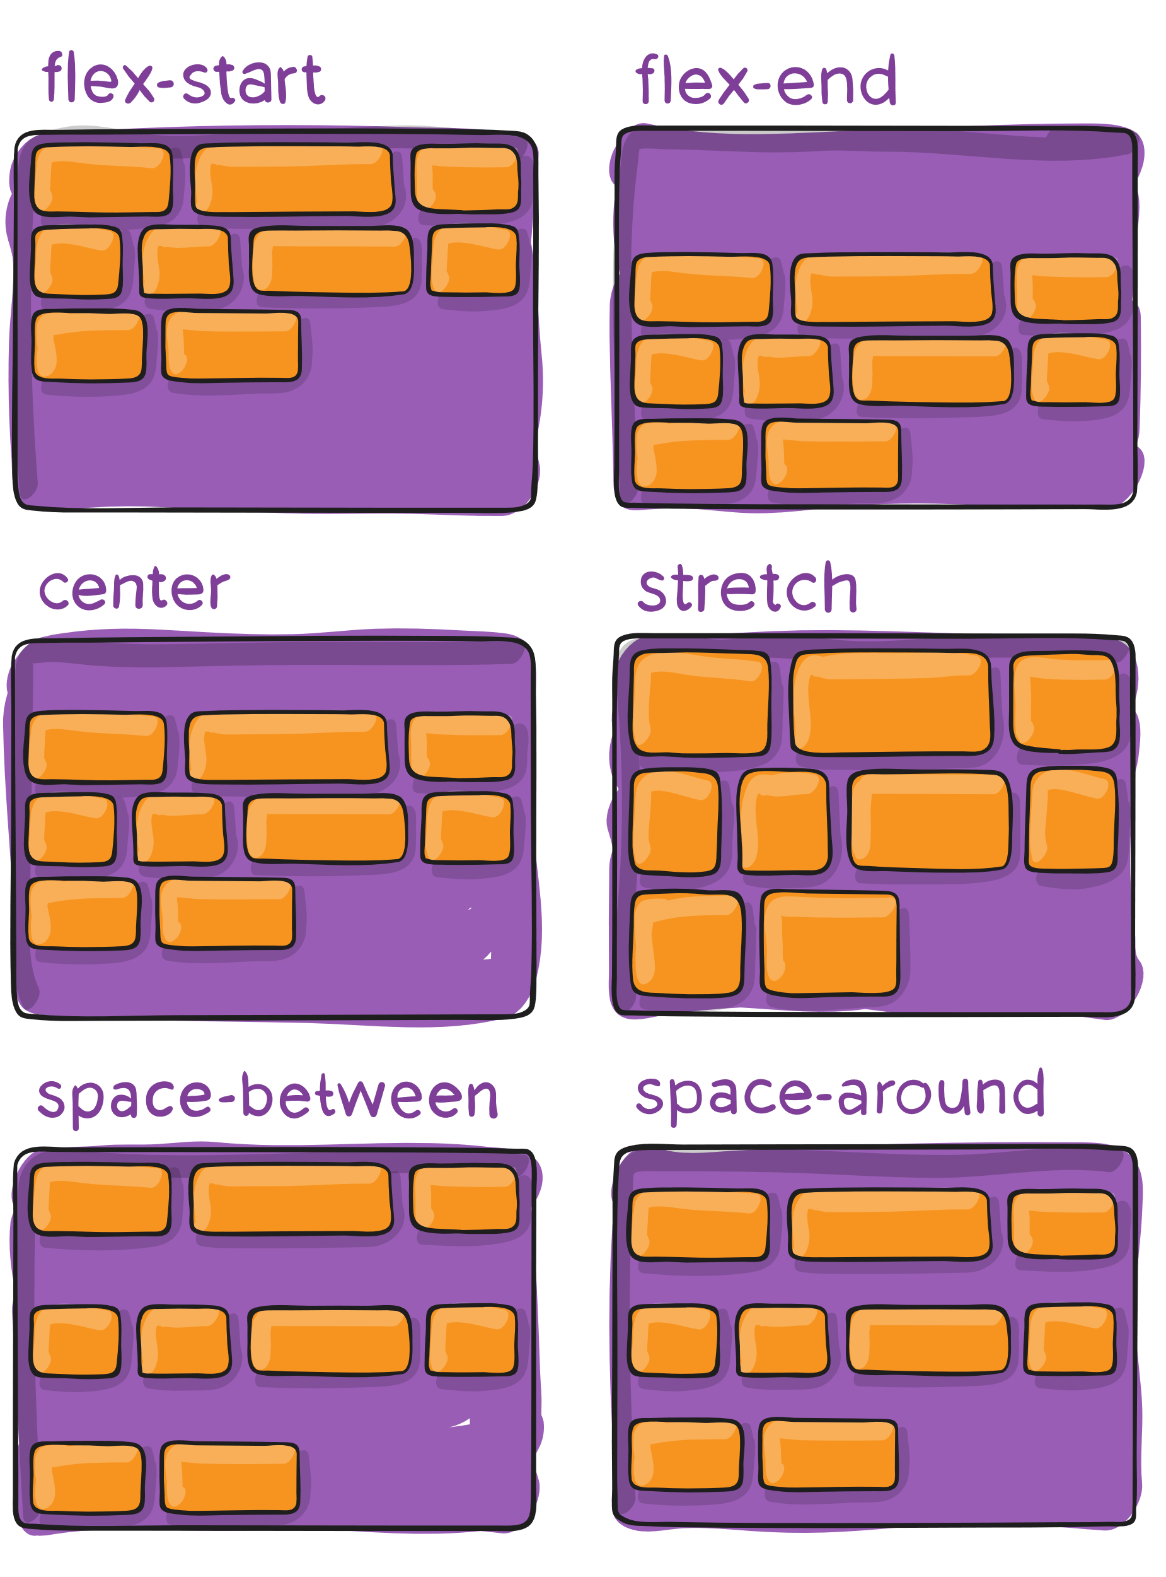
Align Content
align-content aligns the flex lines when we have flex-wrap enabled.
.flex-container {
display: flex;
align-items: center;
}

Slide 33
Gap
gap is a shorthand property which sets the spacing between flex item columns and rows (if wrapped).
gap: row-gap column-gap
Entering only one value sets the gap for both the columns and rows.
.flex-container {
display: flex;
gap: 10px;
}

Slide 34
Flex Item Properties
The flexbox container had the following properties:
flex-direction
flex-wrap
flex-flow
justify-content
align-items
align-content
gap
Flex items can also have some properties:
align-self
order
flex-grow
flex-shrink
flex-basis
flex

Slide 35
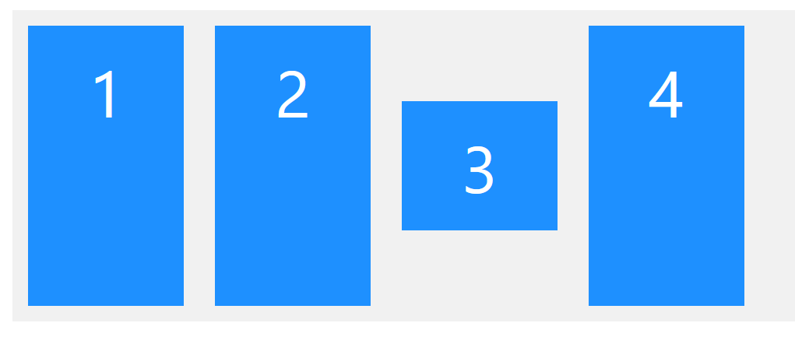
Align Self
The align-self property overrides the container align-items property for only one flex item.
.flex-container>div:nth-child(3) {
align-self: center;
}

Slide 36
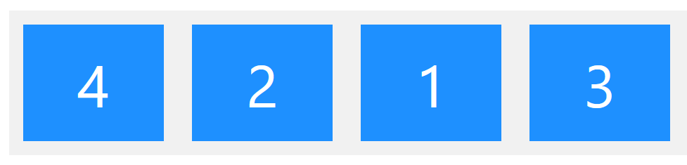
Order
The order property changes the visual order of flex item appearances and ignores the HTML order.
div:nth-child(1) { order: 3; }
div:nth-child(2) { order: 2; }
div:nth-child(3) { order: 4; }
div:nth-child(4) { order: 1; }

Slide 37
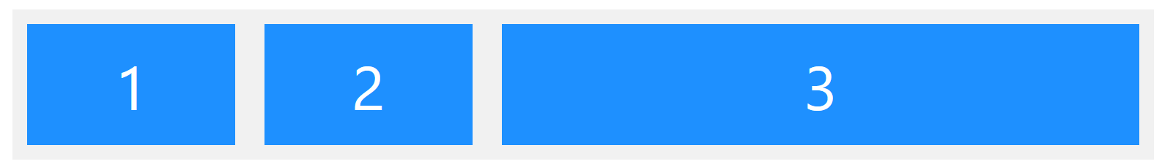
Flex Grow
The flex-grow property specifies how much a flex item grows relative to the rest of the items.
The default is 0.
.flex-container>div:nth-child(3) {
flex-grow: 1;
}

Slide 38
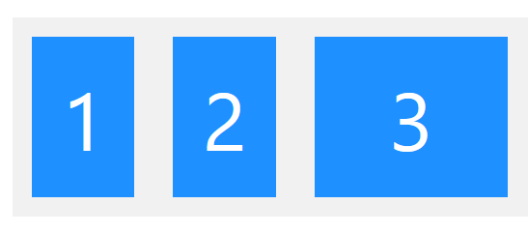
Flex Shrink
The flex-shrink property specifies how much a flex item will shrink relative to the rest of the items.
The default is 1.
.flex-container>div:nth-child(3) {
flex-shrink: 0;
}

Slide 39
Flex Basis
The flex-basis property specifies the initial length of a flex item.
The default is auto (uses the item width).
A value of 0 uses the minimum content width.
.flex-container>div:nth-child(3) {
flex-basis: 200px;
}

Slide 40
Flex
flex is a shorthand property that sets flex-grow, flex-shrink, and flex-basis at the same time.
It is recommended to use the shorthand instead of the longhand properties.
.item {
flex: 1; /* flex-grow: 1, flex-shrink: 1 */
flex: 1 0; /* flex-grow: 1, flex-shrink: 0 */
flex: 1 1 20px; /* flex-grow: 1, flex-shrink: 1, flex-basis: 20px */
}

Slide 41
Tips
To center an element inside of a container, we can use flex with centered justify-content and align-items:
.flex-center {
display: flex;
justify-content: center;
align-items: center;
}

Slide 42
Tips
To make flex items of equal size, we can make all elements have flex-grow:
.flex-container>* {
flex: 1;
}

Slide 43
Tips
To create a grid layout (fixed column count), we can use flex-basis.
First we would have flex-wrap so the items can go to the next line.
Now we use flex-basis to set how many items should be in each line.
For example, if we want 3 columns per line:
.flex-container>* {
flex: 0 0 33.3333%; /* 100 divided by 3 */
}

Slide 44
Variables

Slide 45
Variables
Variables make code cleaner and easier to maintain.
For example, instead of copying the same color everywhere, we can define it in a variable.
Variables are defined inside selectors and can be global or local.
Global variables are defined inside the :root selector which is accessible everywhere.
Local variables are only accessible to the element's children.

Slide 46
Defining Variables
To define a variables, we make a property that starts with two dashes (--):
:root {
--theme-blue: blue;
}
--theme-blue is a global variable.
Variable names are case sensitive and can be changed easily with JS and media queries.
Local scope variables are defined in the same manner.

Slide 47
Using Variables
To use a variable, the var() function is used:
:root {
--theme-blue: blue;
}
header {
background-color: var(--theme-blue);
}
The var function takes a variable name and returns the value set for that variable.
var can optionally take a second parameter which is the fallback value. It is used if the variable is not found.
header {
background-color: var(--theme-blue, #0000ff);
}

Slide 48
Overriding Variables
Local variables can override global variables if they have the same name.
:root {
--theme-blue: blue;
}
aside {
--theme-blue: cyan;
}
aside article {
background-color: var(--theme-blue);
}
Here, articles inside the aside element will use the cyan color instead of blue.

Slide 49
Transform & Transition

Slide 50
Transform
Transforms allow us to move, rotate, scale, and skew elements.
The transform property takes one or multiple transformation methods as the value.
Transform does not work on display: inline elements.
div {
transform: method1(...) method2(...);
}

Slide 51
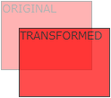
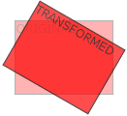
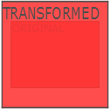
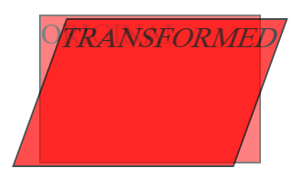
Transform Methods
Translate(X, Y): moves and offsets the element from its current position.
Rotate(degrees): rotates the element clockwise (positive degrees) or counter-clockwise.
Scale(X, Y): scales the element and makes it bigger or smaller. (There is also scaleX and scaleY)
Skew(X, Y): skews the element.
div {
transform: rotate(20deg) scaleX(1.2);
}
translate
rotate
scale
skew

Slide 52
Transition
Transitions allow us to change a property value smoothly over time.
For example, we can change the color of an element smoothly by only stating the starting and ending color.
transition is a shorthand property for:
transition: transition-property transition-duration transition-timing-function transition-delay
We first specify the transition-property, which states which property change are we looking for.
For example, it can be background-color or width or all to set transition for everything.
The transition-duration sets how long it should take to smoothly move to the new value of the property.
button {
transition: all 0.2s;
}

Slide 53
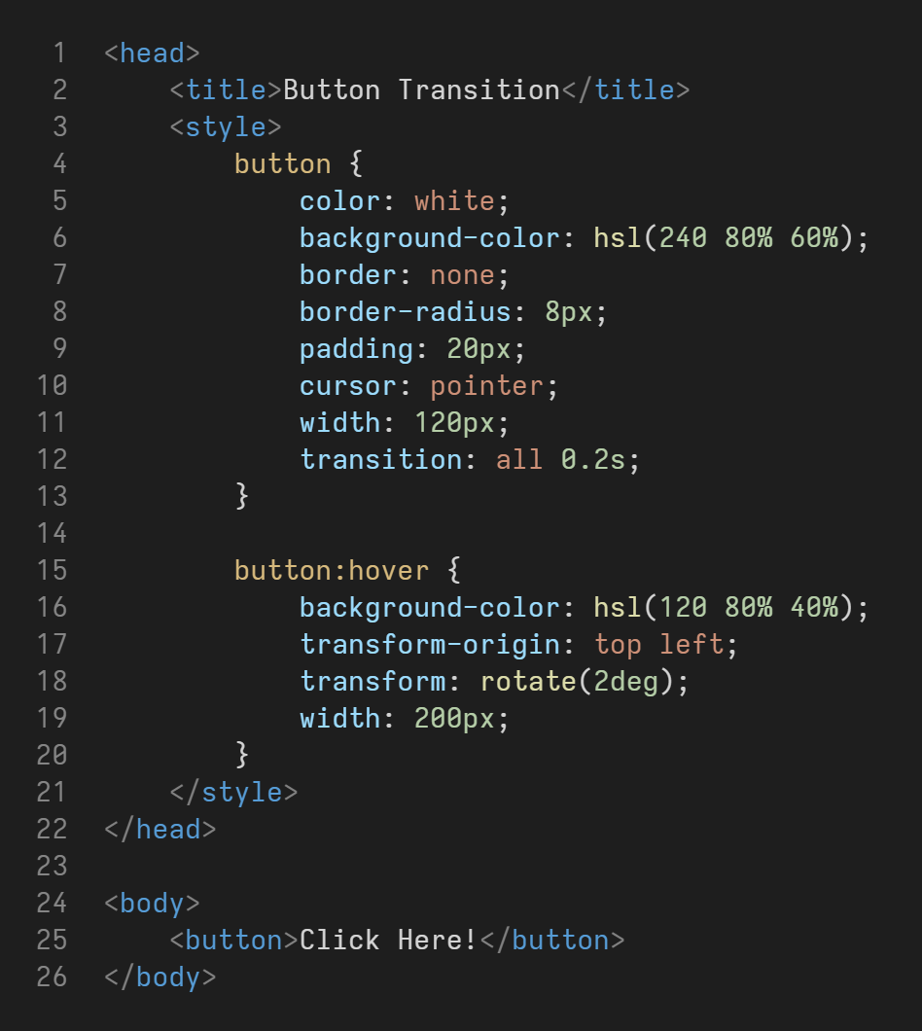

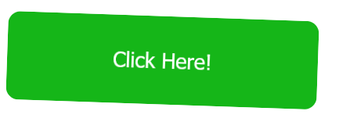
Transition

Slide 54
Thank you for your attention.

